Slide 1
Congestion Control in TCP
Slides credits: https://gaia.cs.umass.edu/kurose_ross/ppt.php

Slide 2
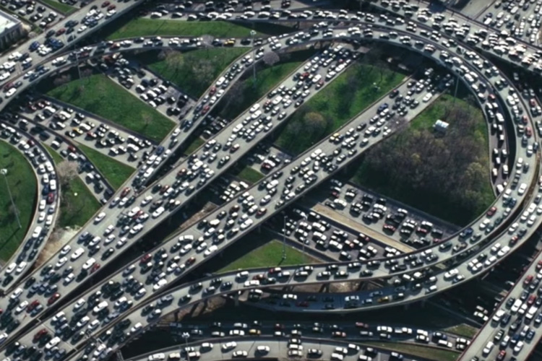

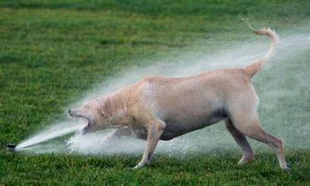
Congestion
informally: “too many sources sending too much data too fast for network to handle”
Packets will be added to the router’s buffer (queue).
different from flow control!
congestion control: too many senders, sending too fast
flow control: one sender too fast for one receiver

Slide 3
TCP’s reaction to congestion
End-end congestion control approach
TCP reacts to congestion by reducing the sender's data transfer rate (aka sender window size).
Sender window size (swnd) = minimum(congestion window size (cwnd), Receiver window size (rwnd))
cwnd - number of bytes the sender may have in the network at any time.
rwnd - number of bytes the receiver can handle.

Slide 4
TCP’s reaction to congestion
TCP's general policy for handling congestion consists of following three phases:
Slow start
Congestion Avoidance
Congestion Detection

Slide 5

TCP slow start
Host A
Host B
Initially, sender sets congestion window size (cwnd) = 1 Maximum Segment Size (MSS).
After receiving each acknowledgment, sender increases the cwnd by 1 MSS (cwnd = cwnd + MSS).
one segment
RTT
two segments
four segments
summary: initial rate is slow, but ramps up exponentially fast
time

Slide 6
TCP slow start (contd.)
In this phase, cwnd increases exponentially.
This phase continues until cwnd reaches a threshold called slow start threshold (ssthresh).
ssthresh = Initially this value is set arbitrarily high, to the size of the flow control window.

Slide 7
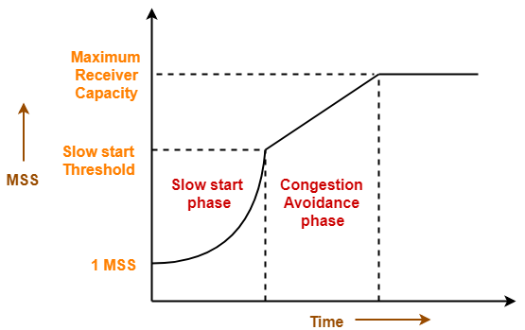
TCP Congestion Avoidance
After cwnd reaches the ssthresh,
Sender increases the cwnd linearly (instead of exponentially) to avoid the congestion (Additive Increase)
This phase continues until the cwnd becomes equal to the receiver window size rwnd.
Source: https://www.gatevidyalay.com/tcp-congestion-control-tcp-protocol-tcp/

Slide 8
TCP Congestion avoidance
Host A
Host B
four segments
RTT
five segments
RTT

Slide 9
TCP Congestion Detection
TCP reacts in different ways based on how the packet loss is detected.
Case-1: Detection on Time Out
Time Out occurs before the sender receives the acknowledgment for a segment.
Reaction:
Setting the ssthresh to half of the current cwnd.
Decreasing the cwnd to 1 MSS.
Resuming the slow start phase.
X

Slide 10
TCP Congestion Detection (contd.)
Case-02: Detection on receiving 3 Duplicate Acknowledgments
Sender receives 3 duplicate acknowledgments for a segment.
This case suggests the weaker possibility of congestion in the network.
A segment has been dropped but few segments sent later may have reached.
Reaction:
Setting the ssthresh to half of the current cwnd. Retransmit the missing segment (Fast retransmit)
Decreasing the cwnd to:
1 MSS and resume the slow start phase (TCP Tahoe).
ssthresh and resume the congestion avoidance phase: additive increase (TCP Reno).
Fast recovery (if the cwnd is decreased to ssthresh instead of 1).
X
TCP Tahoe: Fast Retransmit
TCP Reno: Fast Retransmit + Fast Recovery

Slide 11
TCP congestion control: AIMD
approach: senders can increase sending rate until packet loss (congestion) occurs, then decrease sending rate on loss event
Additive Increase
Multiplicative Decrease
increase sending rate by 1 maximum segment size every RTT until loss detected
cut sending rate in half at each loss event
AIMD sawtooth
behavior
TCP sender Sending rate
time

Slide 12
TCP throughput
avg. TCP throughput as function of window size, RTT?
ignore slow start, assume there is always data to send
W: window size (measured in bytes) where loss occurs
avg. window size (# in-flight bytes) is ¾ W
avg. thruput is 3/4W per RTT
avg TCP thruput =
3
W
4
RTT
bytes/sec
W
W/2

Slide 13
Explicit congestion notification (ECN)
TCP deployments often implement network-assisted congestion control:
two bits in IP header (ToS field) marked by network router to indicate congestion
policy to determine marking chosen by network operator
congestion indication carried to destination
destination sets ECE bit on ACK segment to notify sender of congestion
involves both IP (IP header ECN bit marking) and TCP (TCP header C,E bit marking)
source
TCP ACK segment
destination
application
TCP
network
link
physical
application
TCP
network
link
physical
ECE=1
ECN=10
ECN=11
IP datagram

Slide 14
TCP fairness
Fairness goal: if K TCP sessions share same bottleneck link of bandwidth R, each should have average rate of R/K
TCP connection 1
bottleneck
router
capacity R
TCP connection 2

Slide 15
Q: is TCP Fair?
Example: two competing TCP sessions:
additive increase gives slope of 1, as throughout increases
multiplicative decrease decreases throughput proportionally
R
equal bandwidth share
Is TCP fair?
A: Yes, under idealized assumptions:
same RTT
fixed number of sessions only in congestion avoidance
loss: decrease window by factor of 2
congestion avoidance: additive increase
Connection 2 throughput
loss: decrease window by factor of 2
congestion avoidance: additive increase
Connection 1 throughput
R

Slide 16
Fairness: must all network apps be “fair”?
Fairness and UDP
multimedia apps often do not use TCP
do not want rate throttled by congestion control
instead use UDP:
send audio/video at constant rate, tolerate packet loss
there is no “Internet police” policing use of congestion control
Fairness, parallel TCP connections
application can open multiple parallel connections between two hosts
web browsers do this, e.g., link of rate R with 10 existing connections:
new app asks for 1 TCP, gets rate R/11
new app asks for 10 TCPs, gets R/2

Slide 17
Problem-1
Consider the below figure. Assuming TCP Reno is the protocol experiencing the behavior, answer the following questions. In all cases, you should provide a short discussion justifying your answer.

Slide 18
Problem-1 (contd.)
1. Identify the intervals of time when TCP slow start is operating.
2. Identify the intervals of time when TCP congestion avoidance is operating.
3. After the 16th transmission round, is segment loss detected by a triple duplicate ACK or by a timeout?
4. After the 22nd transmission round, is segment loss detected by a triple duplicate ACK or by a timeout?
5. What is the initial value of ssthresh at the first transmission round?
6. What is the value of ssthresh at the 18th transmission round?
7. What is the value of ssthresh at the 24th transmission round?
8. During what transmission round is the 70th segment sent?
9. Assuming a packet loss is detected after the 26th round by the receipt of a triple duplicate ACK, what will be the values of the congestion window size and of ssthresh?
10. Suppose TCP Tahoe is used (instead of TCP Reno), and assume that triple duplicate ACKs are received at the 16th round. What are the ssthresh and the congestion window size at the 19th round?
11. Again suppose TCP Tahoe is used, and there is a timeout event at 16th round. How many packets have been sent out from 17th round till 22nd round, inclusive?

Slide 19
Solutions
TCP slow start is operating in the intervals [1,6] and [23,26]
TCP congestion avoidance is operating in the intervals [6,16] and [17,22]
After the 16th transmission round, packet loss is recognized by a triple duplicate ACK. If there was a timeout, the congestion window size would have dropped to 1.
After the 22nd transmission round, segment loss is detected due to timeout, and hence the congestion window size is set to 1.
The threshold is initially 32, since it is at this window size that slow start stops and congestion avoidance begins.
The threshold is set to half the value of the congestion window when packet loss is detected. When loss is detected during transmission round 16, the congestion windows size is 42. Hence the threshold is 21 during the 18th transmission round.
The threshold is set to half the value of the congestion window when packet loss is detected. When loss is detected during transmission round 22, the congestion windows size is 29. Hence the threshold is 14 (taking lower floor of 14.5) during the 24th transmission round.
During the 1st transmission round, packet 1 is sent; packet 2-3 are sent in the 2nd transmission round; packets 4-7 are sent in the 3rd transmission round; packets 8-15 are sent in the 4th transmission round; packets 16-31 are sent in the 5th transmission round; packets 32-63 are sent in the 6th transmission round; packets 64 – 96 are sent in the 7th transmission round. Thus packet 70 is sent in the 7th transmission round.

Slide 20
Solutions
The threshold will be set to half the current value of the congestion window (8) when the loss occurred and the congestion window will be set to the new threshold value + 3 MSS. Thus the new values of the threshold and window will be 4 and 7 respectively.
threshold is 21, and congestion window size is 4.
round 17, 1 packet; round 18, 2 packets; round 19, 4 packets; round 20, 8 packets; round 21, 16 packets; round 22, 21 packets. So, the total number is 52.

